Slide 1

AutoAssist: Your Mobile Mechanic App
Transforming roadside assistance with a user-friendly mobile app.
Ishmael Ayallo
Mamo Hamza Malasa
Mshindi Henry Israel
Kithae Derrick Gitonga
Waweru Collins Wambugu

Slide 2
The Problem: Car Breakdowns
Unpredictable
Frustrating
Dangerous
Car breakdowns often happen at inconvenient times and places
Car users struggle to find trusted nearby mechanics
Delays and uncertainty can lead to safety risks

Slide 3
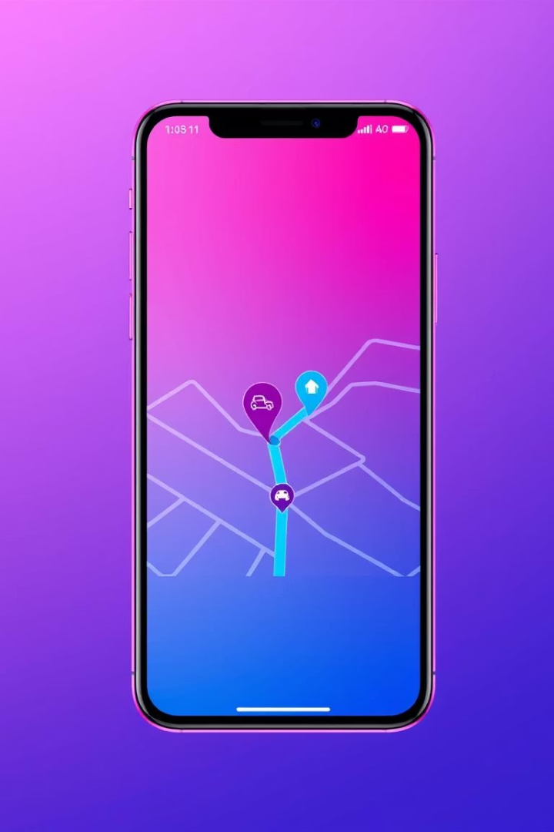




The Solution: AutoAssist
Connects Car Owners and Mechanics
Real-time Location Tracking
One-Tap Service Request
Secure In-App Payments

Slide 4




AutoAssist User Roles
Car Owner
Mechanic
Admin
Request service, track mechanic, pay, rate
Receive requests, navigate, get paid
Manage users, monitor requests, resolve issues

Slide 5

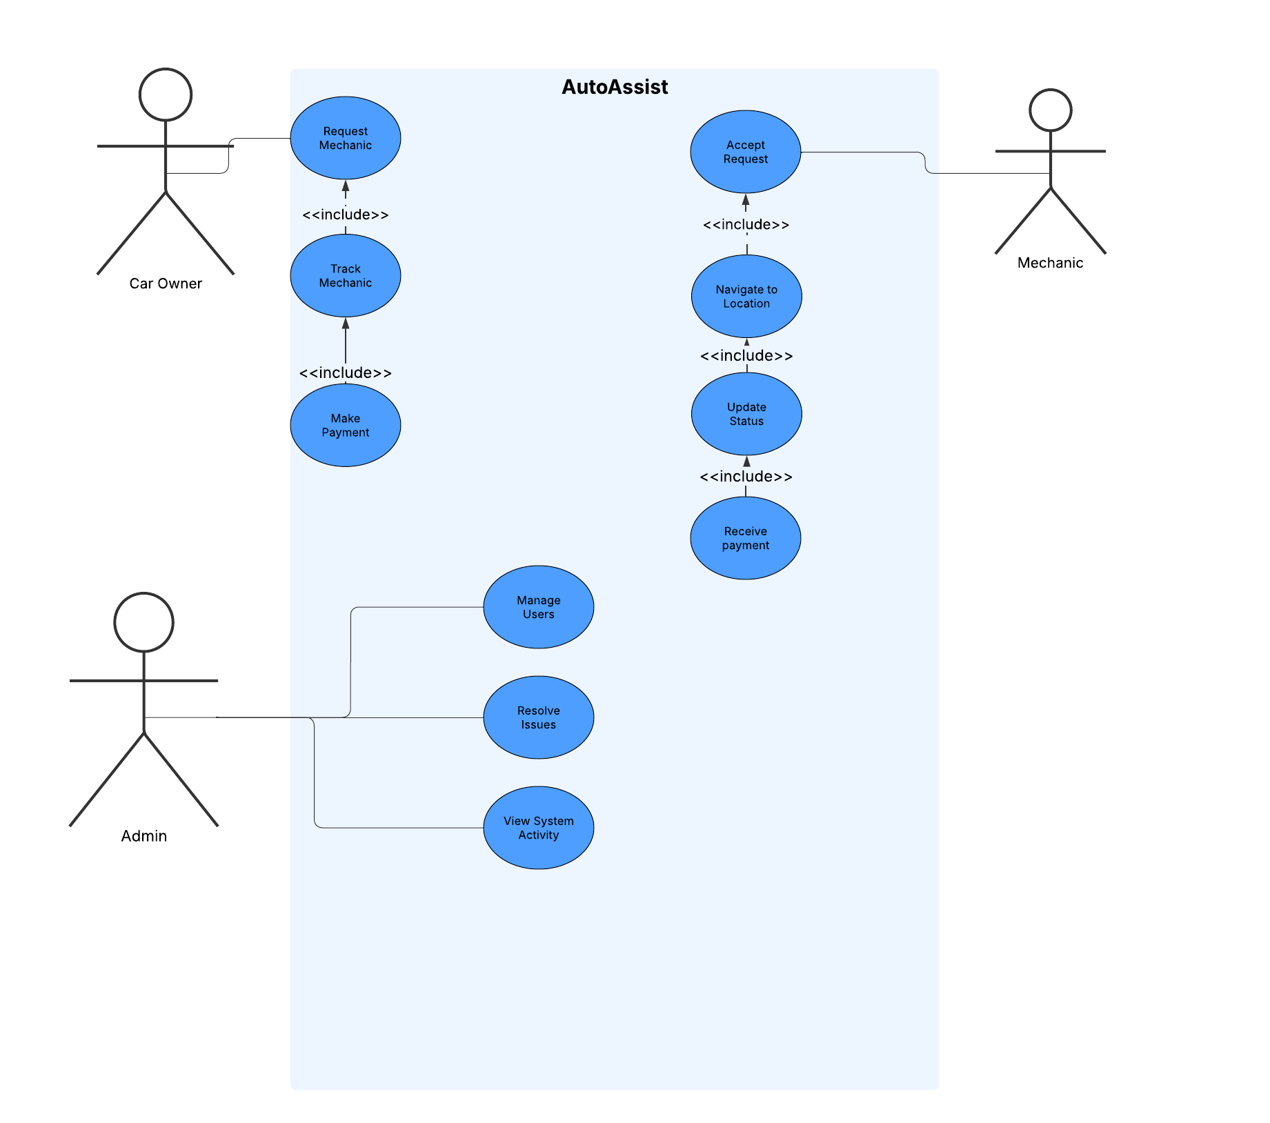
Use Case Diagram

Slide 6
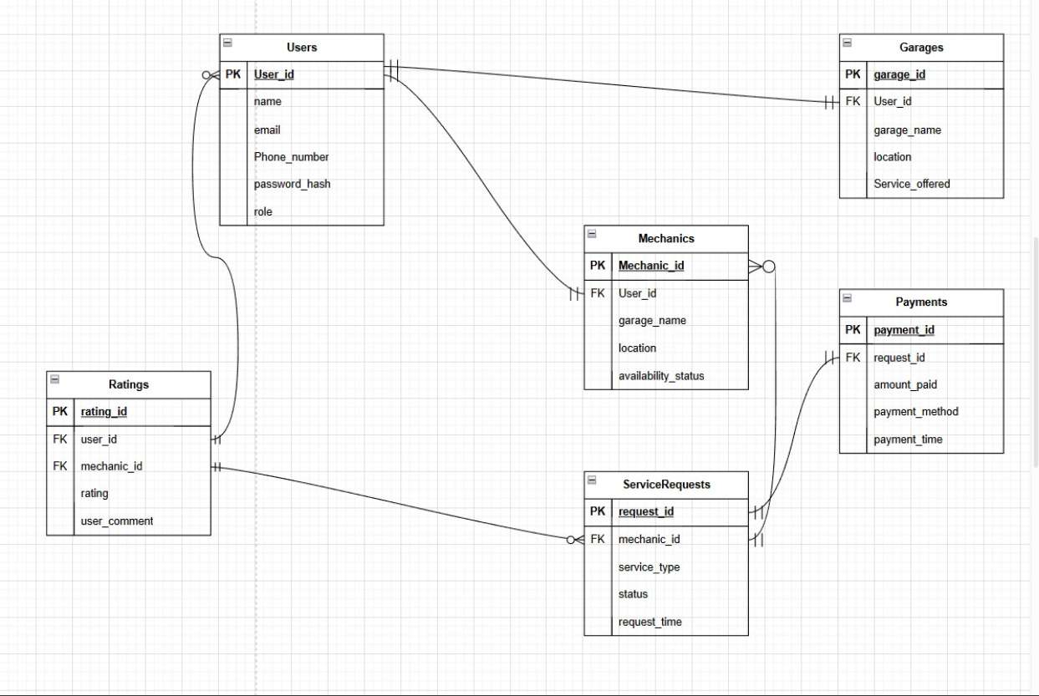
ERD

Slide 7

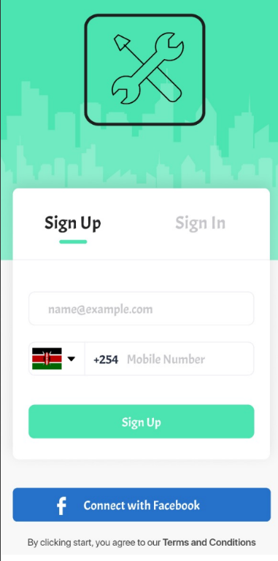
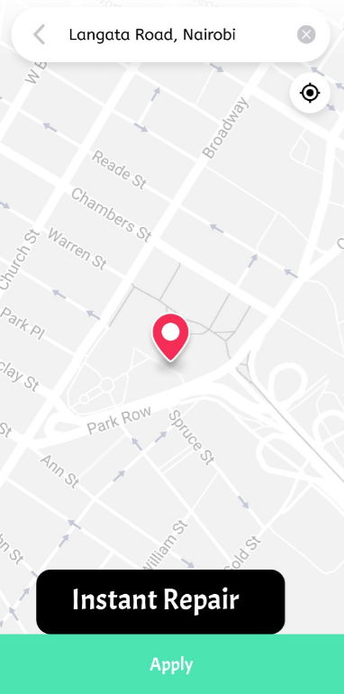
WIREFRAME

Slide 8
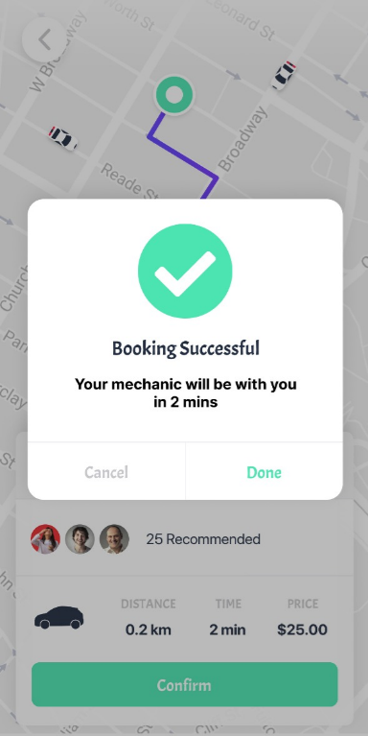
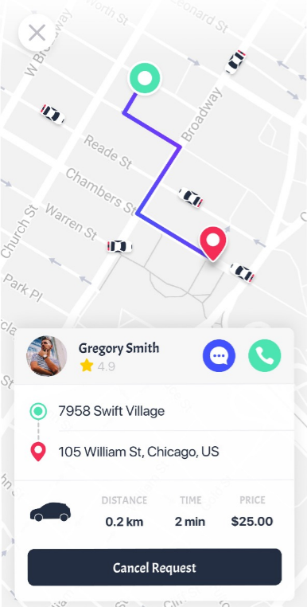
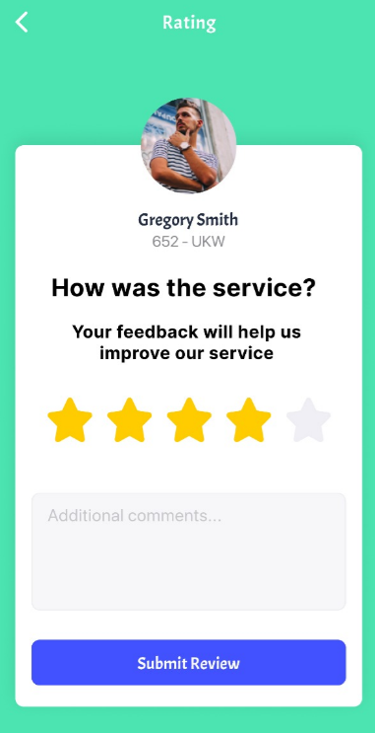
WIREFRAME

Slide 9
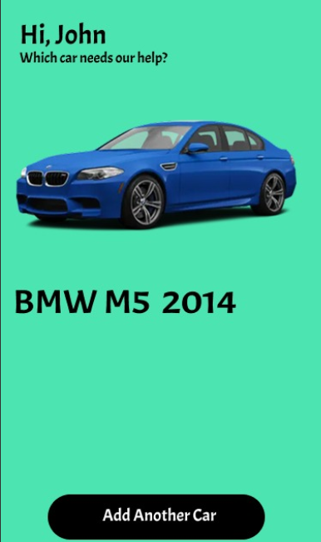
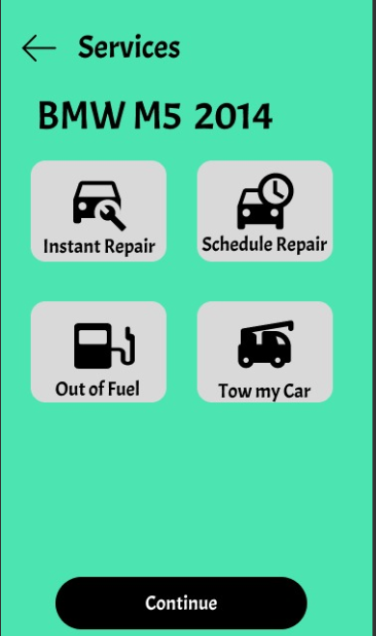
WIREFRAME
This is for a registered user.

Slide 10



Version Control: Git + GitHub
1
Collaboration
2
Version Tracking
3
Code Management

Slide 11

Task Management: Trello
Assign Tasks
Track Progress
Manage Deadlines

Slide 12

Communication: WhatsApp
Real-time Updates
Coordinate Work
Shared Information

